Slide 1
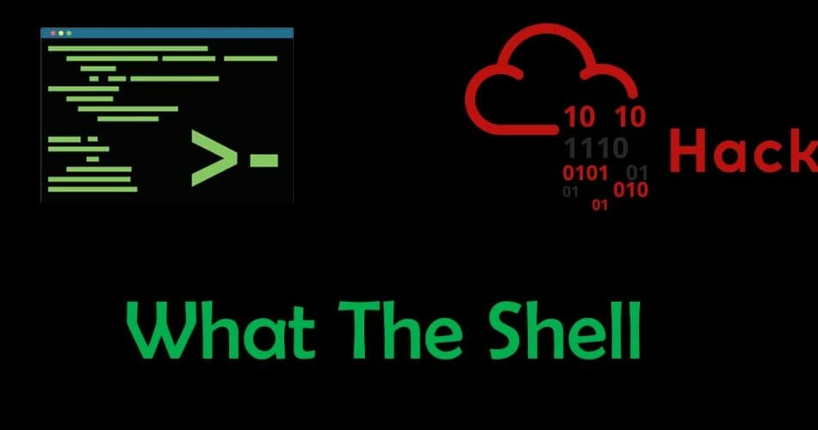

Slide 2
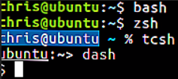
Shells In General
The shell is an interactive interface that allows users to execute other commands and utilities in Linux and other UNIX-based operating systems. When we login to a system the default shell is displayed for us to perform all kinds of operations.

Slide 3
Common Shells
Some of the most common shells in Linux are Bash (Bourne-Again Shell) which is the go-to default shell for most of the Linux Distributions out there. More powerful shells are also available such as zsh (Z-Shell) which incorporates most features of old shells into one, tcsh (Tenex [OS] C shell) which is a better alternative of csh (C shell) and Fish (Friendly interactive shell) which uses color as well to help beginner users.

Slide 4
Common Shells
We talked about shells for Linux and Unix Based systems. That doesn’t mean that other OS don’t have or use shells.
Microsoft for example has DOS (cmd.exe) and Powershell.
Mac uses zsh as it’s default shell and can also have bash.

Slide 5
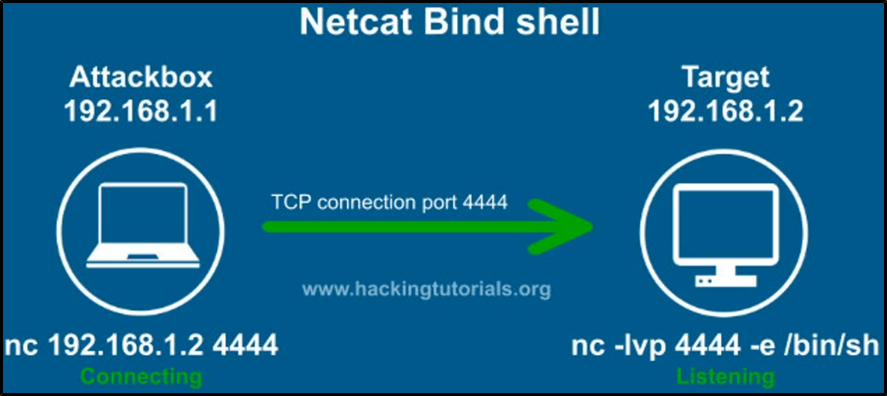
Bind Shells / Backdoor

Slide 6
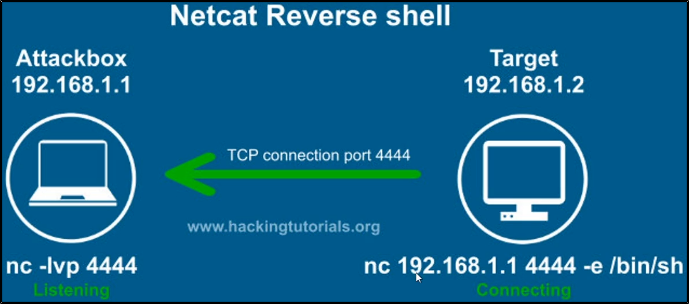
Reverse Shells / One Liners

Slide 7
When to use each?
Reverse Shells
Bind Shells
Victim connects to us
Requires port forward on our end
Outgoing connection from the victim, may bypass firewall rules
We connect to the victim
May require port forward on the victim’s end
Incoming connection so we may get blocked by the victim’s firewall

Slide 8
Malicious Shells
Basic shell access is usually just the beginning for threat actors. When we gain foothold on a compromised machine we tend to use more elegant (custom) shells. Some people write their own to minimize detectability rate and others use the most famous one called meterpreter.

Slide 9
Meterpreter Shell
Meterpreter shell is used along side with metasploit. It uses techniques such as DLL injection to stay on memory without touching the disk in an attempt to stay undetected.
It has a lot more features than normal shells such as a few automatic ways to get system access, enable remote screenshare, enable live video-feed, take photos, play audio, capture microphone, etc. In addition to that it also uses dynamic module loading so you can load custom scripts and get even more powerful commands, such as mimikatz to extract the SAM database for windows systems.

Slide 10
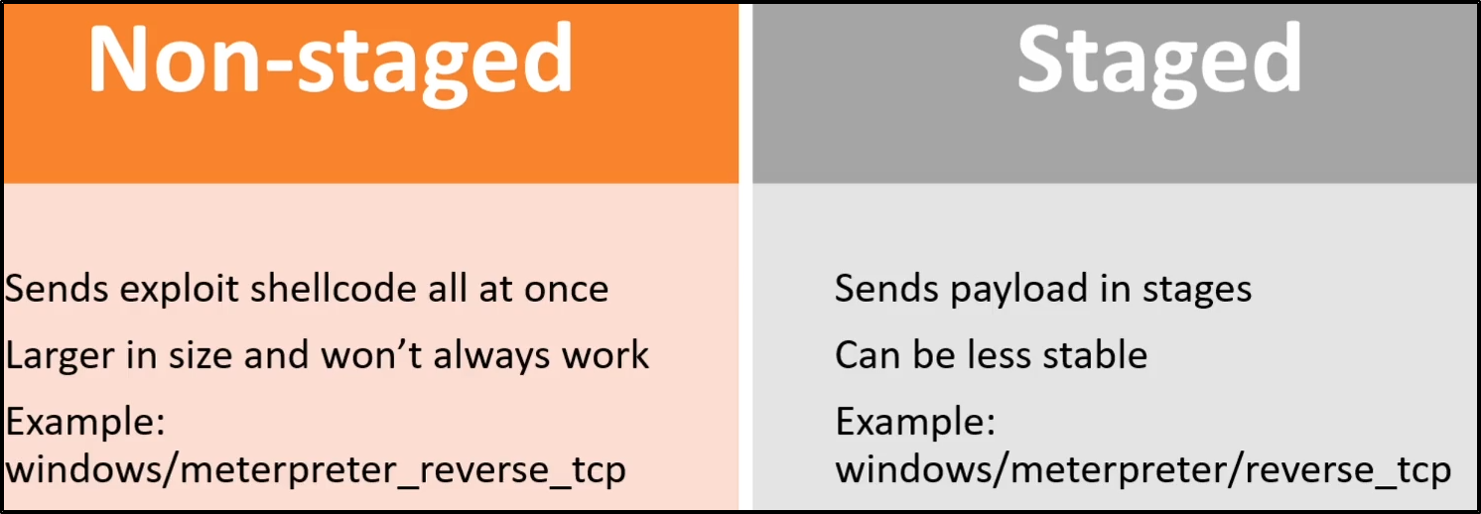
Staged vs Non Staged

